Slide 1
74
Discrete Mathematics
Representing Relations Using Digraphs and Properties

Slide 2
















Slide 3










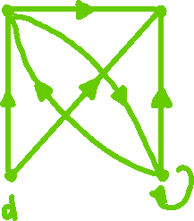



















Slide 4











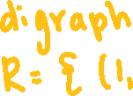



Slide 5
Up Next…
Equivalence Relations

